Slide 1
HNDIT1212: System Analysis and Design
Software Life Cycle Models

Slide 2
Linear or Waterfall Cycle
An approach to system analysis and design
Completes each phase one after another and only once.
Problem Definition
Systems Analysis
Systems Design
Systems Implementation
Systems Testing
Maintenance

Slide 3
Waterfall Strengths
Easy to understand, easy to use
Provides structure to inexperienced staff
Milestones are well understood
Sets requirements stability
Good for management control (plan, staff, track)
Works well when quality is more important than cost or schedule

Slide 4
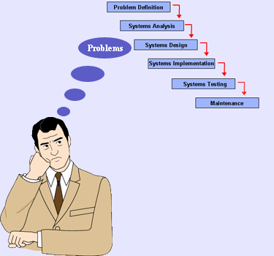
Problems with Waterfall Development Approach

Slide 5
Problems with Waterfall Development Approach……
There are several problems with this approach.
It has a rigid design
Inflexible
It has a top-down procedure
One phase must be completed before the next phase starts
No phase can be repeated
Time consuming

Slide 6
Modified Waterfall development approach
Problem Definition
Systems Analysis
Systems Design
Systems Implementation
Systems Testing
Maintenance
Notes:
It is iterative process model
One process is wrong again correct to before /other before processes.

Slide 7
Modified Waterfall Development Approach
Uses the same phases as the pure waterfall development approach.
Allow some of the stages to overlap, such as the requirements stage and the design stage.
Overlapping stages make it possible to integrate feedback from the design phase into the requirements.
Progress is more difficult to track.

Slide 8
Iterative development approach
Complete
problem
definition
Iteration # 1
Some
System
Analysis
Some
System
Design
Some
System
Implementation
Iteration # 2
More
System
Analysis
More
System
Design
More
System
Implementation
Iteration # 3
Still more
System
Analysis
Still more
System
Design
Still more
System
Implementation
Repeat until no additional iterations needed

Slide 9
Iterative Development Approach
Iterative development approach completes the entire IS in successive iterations.
Each iteration does some
analysis
design
construction
Allows versions of usable information to be delivered in regular and shorter time frames.
The iteration process helps to develop a part of the new system and place it into operation as quickly as possible.

Slide 10
Prototyping
It is very difficult for end-users to anticipate how they will use new software systems to support their work. If the system is large and complex, it is probably impossible to make this assessment before the system is built and put into use.
A prototype ( a small version of the system) can be used to clear the vague requirements. A prototype should be evaluated with the user participation.
There are two types of Prototyping techniques
* Throw-away Prototyping
* Evolutionary Prototyping
Notes:
Vague-not clear

Slide 11
Throw-away and Evolutionary Prototyping
Throw-away
prototyping
Executable prototype +
System specification
Outline
Requirements
Evolutionary
prototyping
Delivered system

Slide 12
Throw-away Prototyping
establish outline specification
develop prototype
evaluate prototype
specify system
components
Delivered
software
system
design and implement system
validate system

Slide 13
Throw-away Prototyping
The objective is to understand the system requirements clearly. Starts with poorly understood requirements. Once the requirements are cleared, the system will be developed from the beginning.
This model is suitable if the requirements are vague but stable.

Slide 14
Some problems with Throw-away Prototyping
Important features may have been left out of the prototype to simplify rapid implementation. In fact, it may not be possible to prototype some of the most important parts of the system such as safety-critical functions.
An implementation has no legal standing as a contract between customer and contractor.
Non-functional requirements such as those concerning reliability, robustness and safety cannot be adequately tested in a prototype implementation.

Slide 15
Evolutionary Prototyping
Develop abstract
specification
Build prototype
system
Evaluate prototype
system
NO
YES
System
Adequate?
Deliver
system

Slide 16
Structured Evolutionary Prototyping Strengths
Customers can “see” the system requirements as they are being gathered
Developers learn from customers
A more accurate end product
Unexpected requirements accommodated
Allows for flexible design and development
Interaction with the prototype stimulates awareness of additional needed functionality

Slide 17
Prototyping Weaknesses
Prototyping can lead to false expectations.
Prototyping can lead to poorly designed systems.
Overall maintainability may be overlooked
The customer may want the prototype delivered.
Process may continue forever (scope creep)
Continual change tends to corrupt the structure of the prototype system. Maintenance is therefore likely to be difficult and costly.

Slide 18
The RAD model
Rapid Application Development (RAD) is an incremental software development process model that emphasizes an extremely short development cycle.
If requirements are well understood and project scope is constrained, the RAD process enables a development team to create a ‘fully functional system’ within very short time periods (eg. 60 to 90 days)

Slide 19
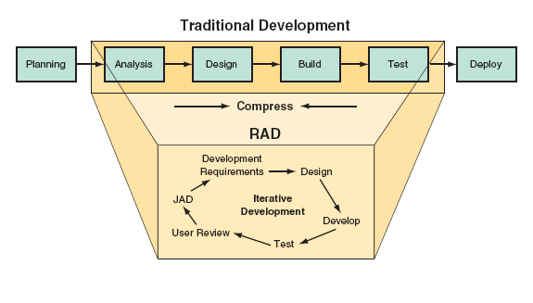

Slide 20
The RAD Model
Team 3
Team 2
Team 1
Business
modeling
Business
modeling
Business
modeling
Data
modeling
Data
modeling
Data
modeling
Process
modeling
Process
modeling
Process
modeling
Application
generation
Application
generation
Application
generation
Testing &
turnover
Testing &
turnover
Testing &
turnover
60 –90 days

Slide 21
Processes in the RAD model
Business modelling - The information flow in a business system considering its functionality.
Data Modelling - The information flow defined as part of the business modelling phase is refined into a set of data objects that are needed to support the business
Process Modelling - The data objects defined in the data modelling phase are transformed to achieve the information flow necessary to implement business functions.
Application generation - RAD assumes the use of 4GL or visual tools to generate the system using reusable components.
Testing and turnover
New components must be tested and all interfaces must be fully exercised
Notes:
Turnover-Pirivatupa

Slide 22
Advantages of RAD
• Can speed up systems development.
• Users thoroughly involved from the start.
• Improves the process of rewriting legacy applications.

Slide 23
Some problems with the RAD model
RAD requires sufficient human resources to create right number of RAD teams
RAD requires developers and customers who are committed to the rapid-fire activities necessary to get a system completed in a much abbreviated time frame.
If a system cannot be properly modularized, building the components necessary for RAD will be problematic.
RAD is not applicable when technical risks are high.

Slide 24
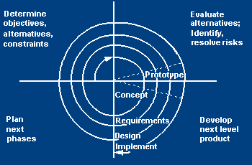
Spiral model
The spiral model (Boehm, 1988) aims at risk reduction by any means in any phase.
quadrant 1
determine objectives of that phase
alternatives and constraints.
quadrant 2
analyzed form the viewpoint of risk
solutions to minimize these risks are investigated, often using prototyping.
quadrant 3
where the traditional waterfall model phases are put into practice.
Quadrant4
the results of the risk-reduction strategies

Slide 25
Spiral model

Slide 26
Spiral Model Strengths
Provides early indication of serious risks, without much cost
Users see the system early because of rapid prototyping tools
Critical high-risk functions are developed first
The design does not have to be perfect
Users can be closely tied to all lifecycle steps
Early and frequent feedback from users

Slide 27
Spiral Model Weaknesses
Time spent for evaluating risks too large for small or low-risk projects
The model is complex
Risk assessment expertise is required
May be hard to define objective, verifiable milestones that indicate readiness to proceed through the next iteration

Slide 28
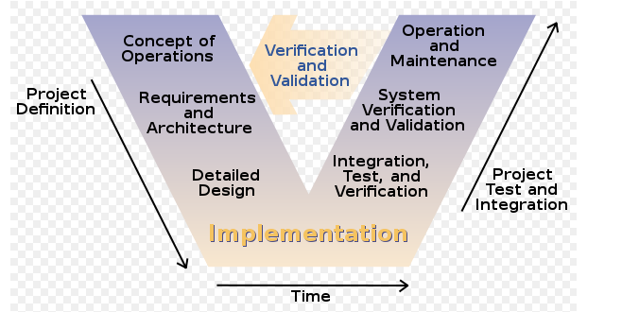
V-Shaped SDLC Model
Testing of the product is planned in parallel with a corresponding phase of development

Slide 29
V-Shaped Strengths
Emphasize planning for verification and validation of the product in early stages of product development
Each deliverable must be testable
Project management can track progress by milestones
Easy to use

Slide 30
V-Shaped Weaknesses
Does not easily handle concurrent events
Does not handle iterations or phases
Does not easily handle dynamic changes in requirements
Does not contain risk analysis activities

Slide 31
Agile Development
Agile development is a software development methodology that delivers functionality in rapid iterations—measured in weeks—requiring frequent communication, development, testing, and delivery.
Agile development focuses on rapid development and frequent user contact to create software that is highly relevant to business users.
This software does not have to include every possible feature the user will require. Rather, it must meet only the basic requirements.

